Slide 1
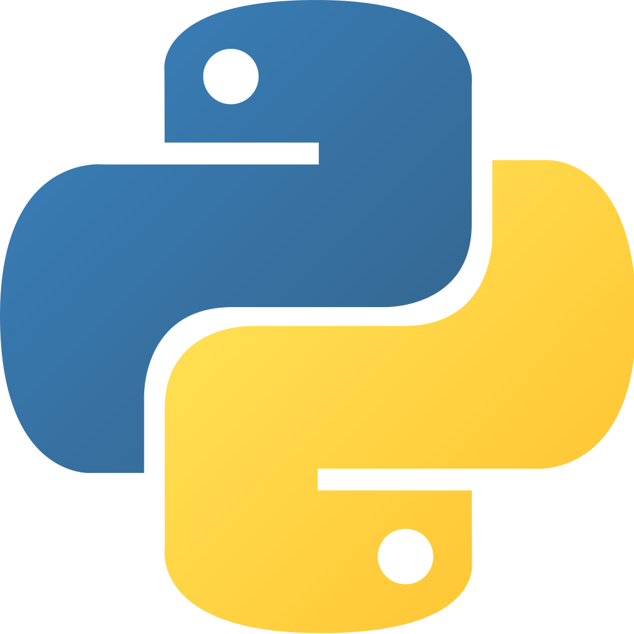
Python3 Programming Language
Achint Chaudhary

Slide 2
Primary Focus
• Learn Python through practical examples
• Learn by doing!
• Provide a few fun programming challenges

Slide 3
Approach
• Coding! Coding! Coding! Coding!
• Introduce yourself to your neighbours
• You're going to work together
• A bit like a hackathon

Slide 4
Your Responsibilities
• Ask questions!
• Don't be afraid to try things
• Read the documentation!
• Ask for help if stuck

Slide 5
Ready, Set, Go...

Slide 6
Presentation Outline
Python Overview
Python Data Types
Python Control Structures
Python Input\output
Python Functions
Python File Handling
Python Exception Handling
Python Modules
Python Classes
Python vs. Java Examples
Python Useful Tools
Who uses Python?

Slide 7
Python features
no compiling or linking | rapid development cycle
no type declarations | simpler, shorter, more flexible
automatic memory management | garbage collection
high-level data types and operations | fast development
object-oriented programming | code structuring and reuse, C++
embedding and extending in C | mixed language systems
classes, modules, exceptions | "programming-in-the-large" support
dynamic loading of C modules | simplified extensions, smaller binaries
dynamic reloading of C modules | programs can be modified without stopping

Slide 8
Python features
universal "first-class" object model | fewer restrictions and rules
run-time program construction | handles unforeseen needs, end-user coding
interactive, dynamic nature | incremental development and testing
access to interpreter information | metaprogramming, introspective objects
wide portability | cross-platform programming without ports
compilation to portable byte-code | execution speed, protecting source code
built-in interfaces to external services | system tools, GUIs, persistence, databases, etc.

Slide 9
Uses of Python
shell tools
system admin tools, command line programs
extension-language work
rapid prototyping and development
language-based modules
instead of special-purpose parsers
graphical user interfaces
database access
distributed programming
Internet scripting

Slide 10
What not to use Python (and kin) for
most scripting languages share these
not as efficient as C
but sometimes better built-in algorithms (e.g., hashing and sorting)
delayed error notification
lack of profiling tools

Slide 11
What is Python?
Python is a high-level programming language which is:
Interpreted: Python is processed at runtime by the interpreter.
Interactive: You can use a Python prompt and interact with the interpreter directly to write your programs.
Object-Oriented: Python supports Object-Oriented technique of programming.
Beginner’s Language: Python is a great language for the beginner-level programmers and supports the development of a wide range of applications.

Slide 12
History of Python
Python was conceptualized by Guido Van Rossum in the late 1980s.
Rossum published the first version of Python code (0.9.0) in February 1991 at the CWI (Centrum Wiskunde & Informatica) in the Netherlands , Amsterdam.
Python is derived from ABC programming language, which is a general-purpose programming language that had been developed at the CWI.
Rossum chose the name "Python", since he was a big fan of Monty Python's Flying Circus.
Python is now maintained by a core development team at the institute, although Rossum still holds a vital role in directing its progress.

Slide 13

Python’s Benevolent Dictator For Life
“Python is an experiment in how much freedom programmers need. Too much freedom and nobody can read another's code; too little and expressive-ness is endangered.”
- Guido van Rossum

Slide 14
Python Versions
Release dates for the major and minor versions:
Python 1.0 - January 1994
Python 1.5 - December 31, 1997
Python 1.6 - September 5, 2000
Python 2.0 - October 16, 2000
Python 2.1 - April 17, 2001
Python 2.2 - December 21, 2001
Python 2.3 - July 29, 2003
Python 2.4 - November 30, 2004
Python 2.5 - September 19, 2006
Python 2.6 - October 1, 2008
Python 2.7 - July 3, 2010

Slide 15
Python Versions
Release dates for the major and minor versions:
Python 3.0 - December 3, 2008
Python 3.1 - June 27, 2009
Python 3.2 - February 20, 2011
Python 3.3 - September 29, 2012
Python 3.4 - March 16, 2014
Python 3.5 - September 13, 2015

Slide 16


Key Changes in Python 3.0
Python 2's print statement has been replaced by the print() function.
There is only one integer type left, int.
Some methods such as map() and filter( ) return iterator objects in Python 3 instead of lists in Python 2.
In Python 3, a TypeError is raised as warning if we try to compare unorderable types. e.g. 1 < ’ ', 0 > None are no longer valid
Python 3 provides Unicode (utf-8) strings while Python 2 has ASCII str( ) types and separate unicode( ).
A new built-in string formatting method format() replaces the % string formatting operator.

Slide 17


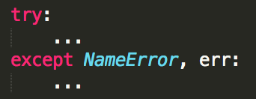
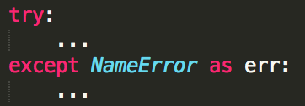
Key Changes in Python 3.0
In Python 3, we should enclose the exception argument in parentheses.
In Python 3, we have to use the as keyword now in the handling of exceptions.
The division of two integers returns a float instead of an integer. "//" can be used to have the "old" behavior.

Slide 18
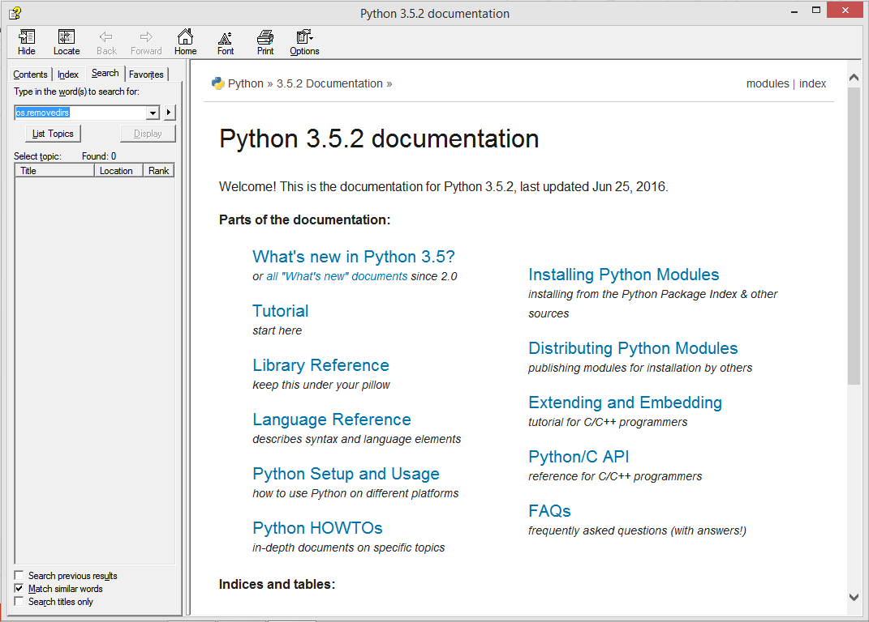
http://docs.python.org/

Slide 19
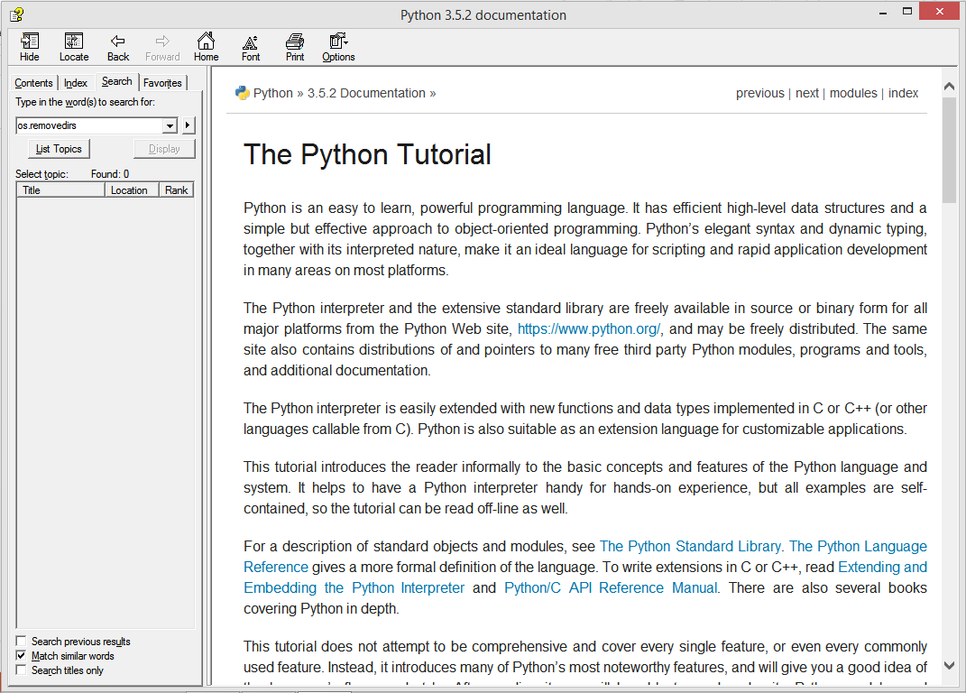
The Python tutorial is Great !

Slide 20
Running Python

Slide 21
The Python Interpreter
Typical Python implementations offer both an interpreter and compiler
Interactive interface to Python with a read-evaluate-print loop
C:\Users\Achint> python
Python 3.5.2 (v3.5.2:4def2a2901a5, Jun 25 2016, 22:18:55) [MSC
v.1900 64 bit (AMD64)] on win32
Type "help", "copyright", "credits" or "license" for more information.
>>> def square(x):
... return x * x
...
>>> map(square, [1, 2, 3, 4])
[1, 4, 9, 16]
>>>

Slide 22
Installing - Python
Python is pre-installed on most Unix systems, including Linux and MAC OS X
The pre-installed version may not be the most recent one (2.7.12 and 3.5.2 as of Oct 2016)
Download from http://python.org/download/
Python comes with a large library of standard modules
There are several options for an IDE
IDLE – works well with Windows
Emacs with python-mode or your favorite text editor
Eclipse with Pydev (http://pydev.sourceforge.net/)

Slide 23
IDLE Development Environment
IDLE is an Integrated Development Environ-ment for Python, typically used on Windows
Multi-window text editor with syntax highlighting, auto-completion, smart indent and other.
Python shell with syntax highlighting.
Integrated debugger with stepping, persistent breakpoints, and call stack visibility.

Slide 24
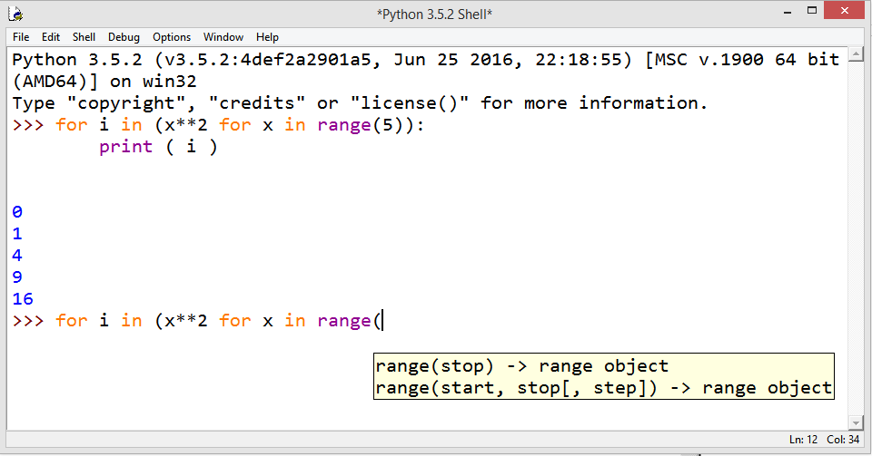
Running Interactively on Windows

Slide 25
Running Interactively on UNIX/Linux
On Unix…
% python
>>> 3+3
6
Python prompts with ‘>>>’.
To exit Python (not Idle):
In Unix, type CONTROL-D
In Windows, type CONTROL-Z + <Enter>
Evaluate exit()

Slide 26
Running Programs on UNIX/Linux
Call python program via the python interpreter
% python fact.py
Make a python file directly executable by
Adding the appropriate path to your python interpreter as the first line of your file
#!/usr/bin/python
Making the file executable
% chmod a+x fact.py
Invoking file from Unix command line
% fact.py

Slide 27
Example ‘script’: fact.py
def fact(x): """Returns the factorial of its argument, assumed to be a positive integer"""
if x == 0:
return 1
return x * fact(x - 1)
print ( “N fact(N)” )
print ( "---------“ )
for n in range(10):
print ( n, fact(n) )

Slide 28
Python Scripts
When you call a python program from the command line the interpreter evaluates each expression in the file
Familiar mechanisms are used to provide command line arguments and/or redirect input and output
Python also has mechanisms to allow a python program to act both as a script and as a module to be imported and used by another python program

Slide 29
Simple functions: ex.py
"""factorial done recursively and iteratively"""
def fact1(n):
ans = 1
for i in range(2,n):
ans = ans * n
return ans
def fact2(n):
if n < 1:
return 1
else:
return n * fact2(n - 1)

Slide 30
Simple functions: ex.py
>>> python
Python 3.5.2 …
>>> import ex
>>> ex.fact1(6)
1296
>>> ex.fact2(200)
78865786736479050355236321393218507…000000L
>>> ex.fact1
<function fact1 at 0x902470>
>>> fact1
Traceback (most recent call last):
File "<stdin>", line 1, in <module>
NameError: name 'fact1' is not defined

Slide 31
Python Syntax
By Achint Chaudhary

Slide 32
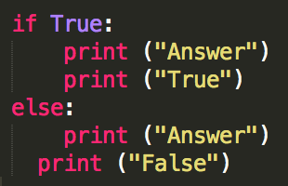


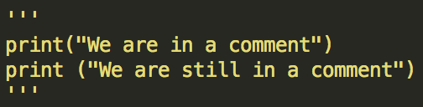
Basic Syntax
Indentation is used in Python to delimit blocks. The number of spaces is variable, but all statements within the same block must be indented the same amount.
The header line for compound statements, such as if, while, def, and class should be terminated with a colon ( : )
The semicolon ( ; ) is optional at the end of statement.
Printing to the Screen:
Reading Keyboard Input:
Comments
Single line:
Multiple lines:
Python files have extension .py

Slide 33
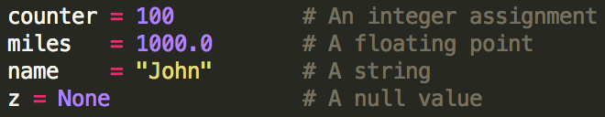



Variables
Python is dynamically typed. You do not need to declare variables!
The declaration happens automatically when you assign a value to a variable.
Variables can change type, simply by assigning them a new value of a different type.
Python allows you to assign a single value to several variables simultaneously.
You can also assign multiple objects to multiple variables.

Slide 34
Python Data Types
By Achint Chaudhary

Slide 35
Numbers
Numbers are Immutable objects in Python that cannot change their values.
There are three built-in data types for numbers in Python3:
Integer (int)
Floating-point numbers (float)
Complex numbers: <real part> + <imaginary part>j (not used much in Python programming)
Common Number Functions
Function | Description
int(x) | to convert x to an integer
float(x) | to convert x to a floating-point number
abs(x) | The absolute value of x
cmp(x,y) | -1 if x < y, 0 if x == y, or 1 if x > y
exp(x) | The exponential of x: e^{x}
log(x) | The natural logarithm of x, for x> 0
pow(x,y) | The value of x**y
sqrt(x) | The square root of x for x > 0

Slide 36
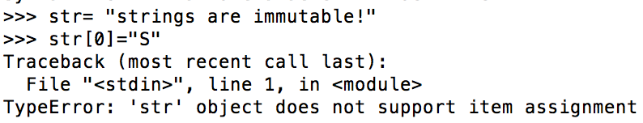
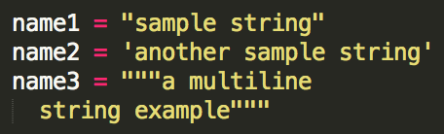
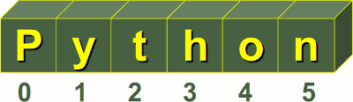
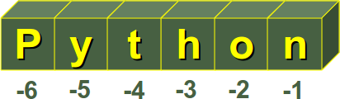
Strings
Python Strings are Immutable objects that cannot change their values.
You can update an existing string by (re)assigning a variable to another string.
Python does not support a character type; these are treated as strings of length one.
Python accepts single ('), double (") and triple (''' or """) quotes to denote string literals.
String indexes starting at 0 in the beginning of the string and working their way from -1 at the end.

Slide 37
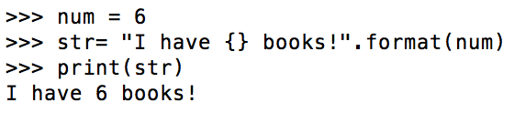
Strings
String Formatting
Common String Operators
Assume string variable a holds 'Hello' and variable b holds 'Python’
Operator | Description | Example
+ | Concatenation - Adds values on either side of the operator | a + b will give HelloPython
* | Repetition - Creates new strings, concatenating multiple copies of the same string | a*2 will give HelloHello
[ ] | Slice - Gives the character from the given index | a[1] will give e a[-1] will give o
[ : ] | Range Slice - Gives the characters from the given range | a[1:4] will give ell
in | Membership - Returns true if a character exists in the given string | ‘H’ in a will give True

Slide 38
Strings
Common String Methods
Method | Description
str.count(sub, beg= 0,end=len(str))
str.isalpha()
str.isdigit()
str.lower()
str.upper()
str.replace(old, new)
str.split(str=‘ ’)
str.strip()
str.title()
Counts how many times sub occurs in string or in a substring of string if
starting index beg and ending index end are given.
Returns True if string has at least 1 character and all characters are alphanumeric and False otherwise.
Returns True if string contains only digits and False otherwise.
Converts all uppercase letters in string to lowercase.
Converts lowercase letters in string to uppercase.
Replaces all occurrences of old in string with new.
Splits string according to delimiter str (space if not provided)
and returns list of substrings.
Removes all leading and trailing whitespace of string.
Returns "titlecased" version of string.
Common String Functions str(x) :to convert x to a string
len(string):gives the total length of the string

Slide 39
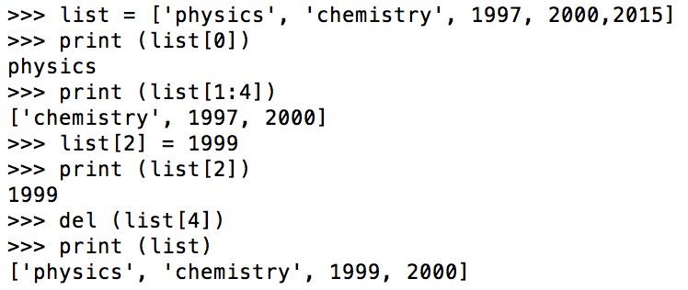
Lists
A list in Python is an ordered group of items or elements, and these list elements don't have to be of the same type.
Python Lists are mutable objects that can change their values.
A list contains items separated by commas and enclosed within square brackets.
List indexes like strings starting at 0 in the beginning of the list and working their way from -1 at the end.
Similar to strings, Lists operations include slicing ([ ] and [:]) , concatenation (+), repetition (*), and membership (in).
This example shows how to access, update and delete list elements:

Slide 40
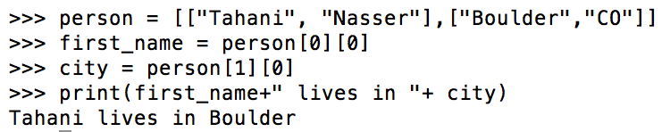
Lists
Lists can have sublists as elements and these sublists may contain other sublists as well.
Common List Functions
Function | Description
cmp(list1, list2) | Compares elements of both lists.
len(list) | Gives the total length of the list.
max(list) | Returns item from the list with max value.
min(list) | Returns item from the list with min value.
list(tuple) | Converts a tuple into list.

Slide 41
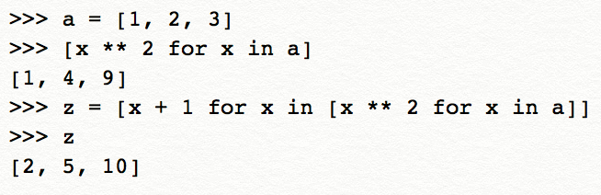
Lists
Method | Description
list.append(obj) | Appends object obj to list
list.insert(index, obj) | Inserts object obj into list at offset index
list.count(obj) | Returns count of how many times obj occurs in list
list.index(obj) | Returns the lowest index in list that obj appears
list.remove(obj) | Removes object obj from list
list.reverse() | Reverses objects of list in place
list.sort() | Sorts objects of list in place
Common List Methods
List Comprehensions
Each list comprehension consists of an expression followed by a for clause.
→ List comprehension

Slide 42
Tuples
Python Tuples are Immutable objects that cannot be changed once they have been created.
A tuple contains items separated by commas and enclosed in parentheses instead of square brackets.
You can update an existing tuple by (re)assigning a variable to another tuple.
Tuples are faster than lists and protect your data against accidental changes to these data.
The rules for tuple indices are the same as for lists and they have the same operations, functions as well.
To write a tuple containing a single value, you have to include a comma, even though there is only one value. e.g. t = (3, )

Slide 43
Dictionary
Python's dictionaries are kind of hash table type which consist of key-value pairs of unordered elements.
Keys : must be immutable data types ,usually numbers or strings.
Values : can be any arbitrary Python object.
Python Dictionaries are mutable objects that can change their values.
A dictionary is enclosed by curly braces ({ }), the items are separated by commas, and each key is separated from its value by a colon (:).
Dictionary’s values can be assigned and accessed using square braces ([]) with a key to obtain its value.

Slide 44
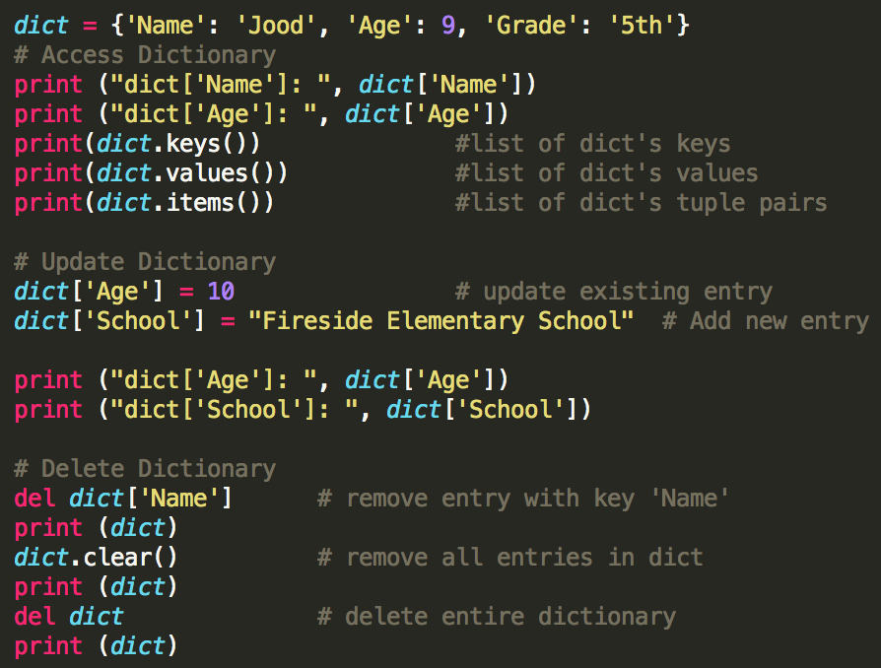
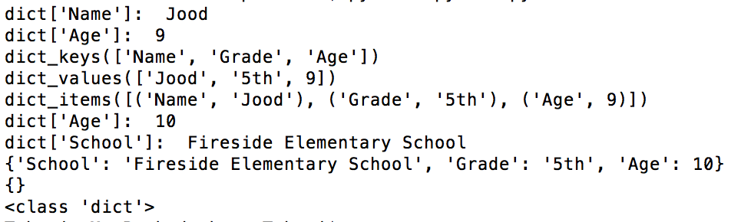
Dictionary
This example shows how to access, update and delete dictionary elements:
The output:

Slide 45
Dictionary
Common Dictionary Functions
cmp(dict1, dict2) : compares elements of both dict.
len(dict) : gives the total number of (key, value) pairs in the dictionary.
Common Dictionary Methods
Method | Description
dict.keys() | Returns list of dict's keys
dict.values() | Returns list of dict's values
dict.items() | Returns a list of dict's (key, value) tuple pairs
dict.get(key, default=None) | For key, returns value or default if key not in dict
dict.has_key(key) | Returns True if key in dict, False otherwise
dict.update(dict2) | Adds dict2's key-values pairs to dict
dict.clear() | Removes all elements of dict

Slide 46
Python Control Structures
By Achint Chaudhary

Slide 47

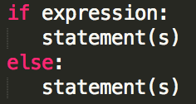
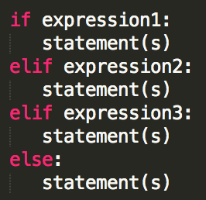
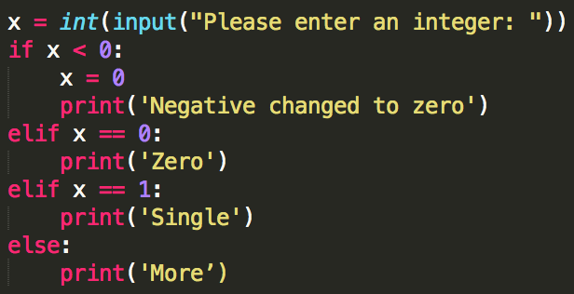
Conditionals
In Python, True and False are Boolean objects of class 'bool' and they are immutable.
Python assumes any non-zero and non-null values as True, otherwise it is False value.
Python does not provide switch or case statements as in other languages.
Syntax:
if Statement if..else Statement if..elif..else Statement
Example:

Slide 48
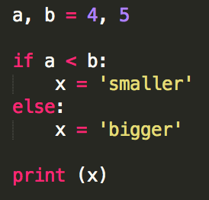

Conditionals
Using the conditional expression
Another type of conditional structure in Python, which is very convenient and easy to read.
→

Slide 49
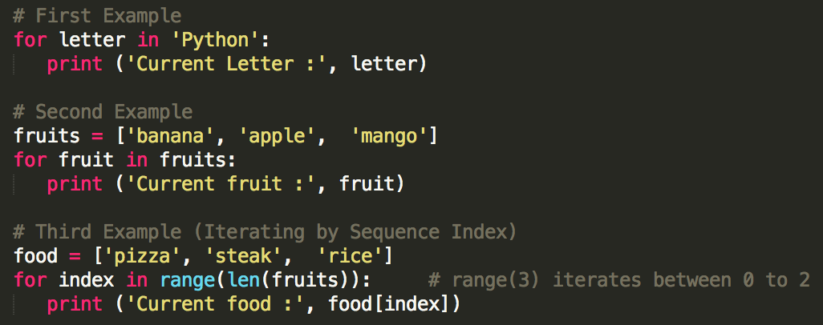
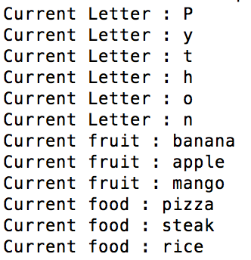

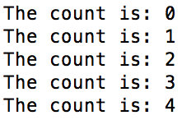
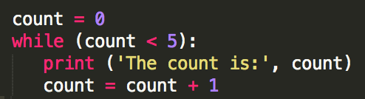
Loops
The For Loop
The while Loop

Slide 50
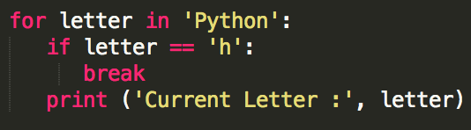

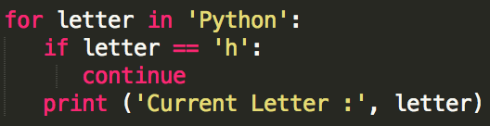
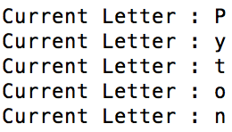
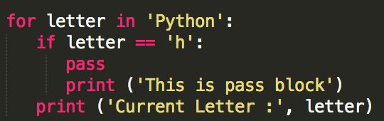
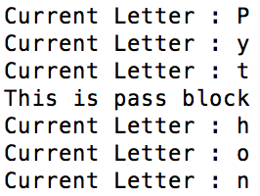
Loops
Loop Control Statements
break :Terminates the loop statement and transfers execution to the statement immediately following the loop.
continue :Causes the loop to skip the remainder of its body and immediately retest its condition prior to reiterating.
pass :Used when a statement is required syntactically but you do not want any command or code to execute.

Slide 51
Python Functions
By Achint Chaudhary

Slide 52
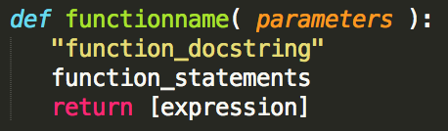
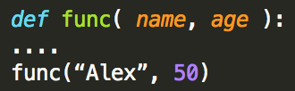
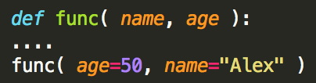
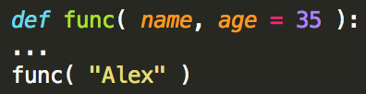
Functions
Function Syntax
Function Arguments
You can call a function by using any of the following types of arguments:
Required arguments: the arguments passed to the function in correct positional order.
Keyword arguments: the function call identifies the arguments by the parameter names.
Default arguments: the argument has a default value in the function declaration used when the value is not provided in the function call.

Slide 53
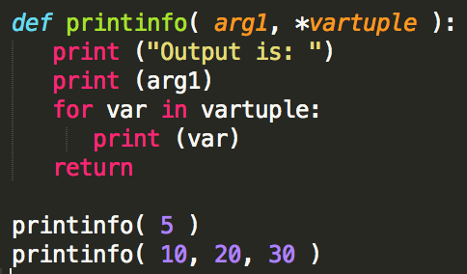
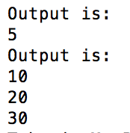
Functions
Variable-length arguments: This used when you need to process unspecified additional arguments. An asterisk (*) is placed before the variable name in the function declaration.

Slide 54
Python File Handling
By Achint Chaudhary

Slide 55
File Handling
File opening fileObject = open(file_name [, access_mode][, buffering])
Common access modes:
“r” opens a file for reading only.
“w” opens a file for writing only. Overwrites the file if the file exists. Otherwise, it creates a new file.
“a” opens a file for appending. If the file does not exist, it creates a new file for writing.
Closing a file fileObject.close()
The close() method flushes any unwritten information and closes the file object.

Slide 56
File Handling
Reading a file fileObject.read([count])
The read() method reads the whole file at once.
The readline() method reads one line each time from the file.
The readlines() method reads all lines from the file in a list.
Writing in a file fileObject.write(string)
The write() method writes any string to an open file.

Slide 57
Python Exception Handling
By Achint Chaudhary

Slide 58
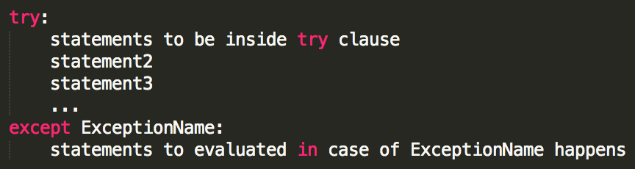
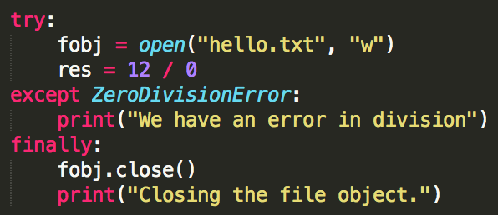

Exception Handling
Common Exceptions in Python:
NameError - TypeError - IndexError - KeyError - Exception
Exception Handling Syntax:
An empty except statement can catch any exception.
finally clause: always executed before finishing try statements.
→

Slide 59
Python Modules
By Achint Chaudhary

Slide 60


Modules
A module is a file consisting of Python code that can define functions, classes and variables.
A module allows you to organize your code by grouping related code which makes the code easier to understand and use.
You can use any Python source file as a module by executing an import statement
Python's from statement lets you import specific attributes from a module into the current namespace.
import * statement can be used to import all names from a module into the current namespace

Slide 61
Python Object Oriented
By Achint Chaudhary

Slide 62
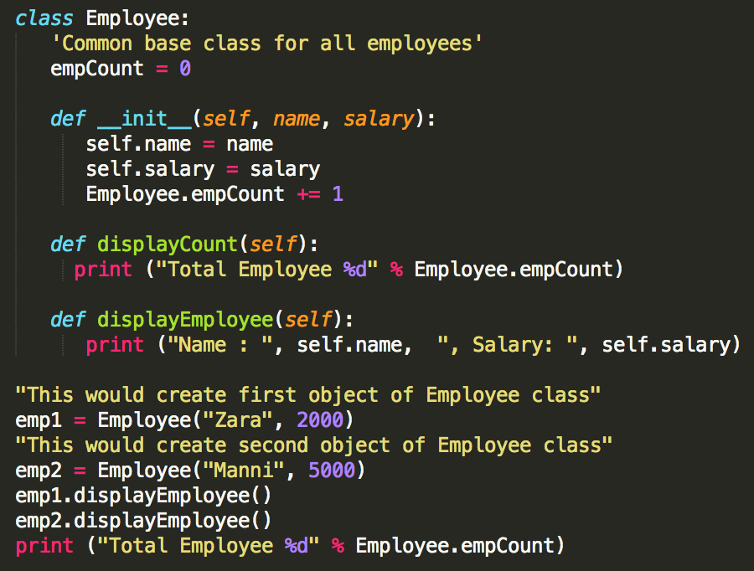
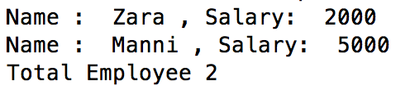
Python Classes
→ Class variable
→ Class constructor
Output →

Slide 63
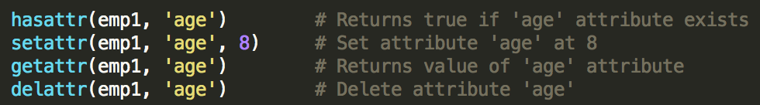

Python Classes
Built-in class functions
getattr(obj, name[, default]) : to access the attribute of object.
hasattr(obj,name) : to check if an attribute exists or not.
setattr(obj,name,value) : to set an attribute. If attribute does not exist, then it would be created.
delattr(obj, name) : to delete an attribute.
Data Hiding You need to name attributes with a double underscore prefix, and those attributes then are not be directly visible to outsiders.

Slide 64
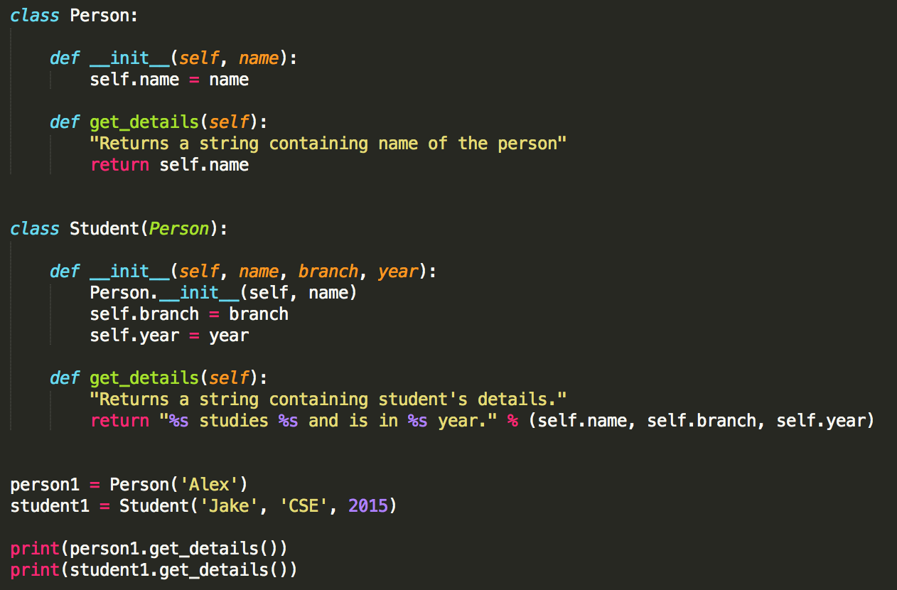

Class Inheritance

Slide 65
Python vs. Java Code Examples
By Achint Chaudhary

Slide 66
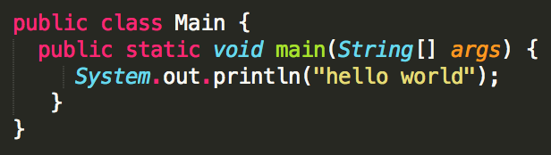

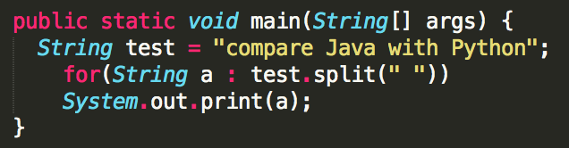

Python vs. Java
Hello World
String Operations
Java
Python
Java
Python

Slide 67
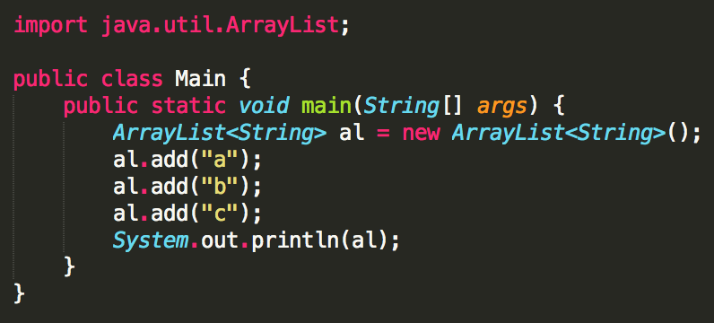
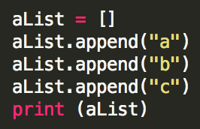
Python vs. Java
Collections
Java
Python

Slide 68
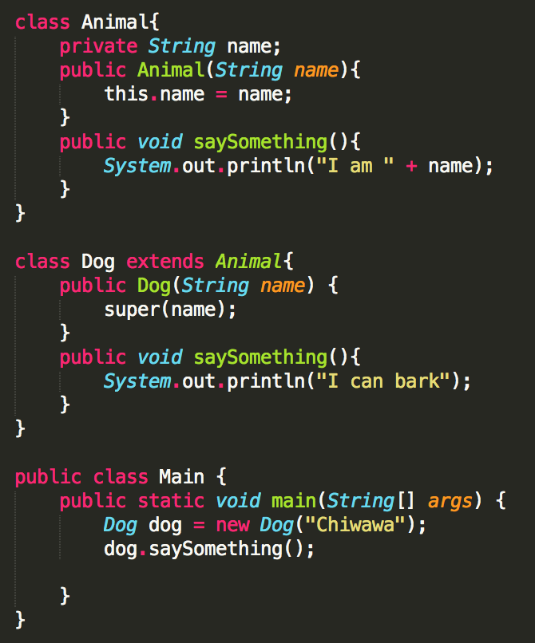
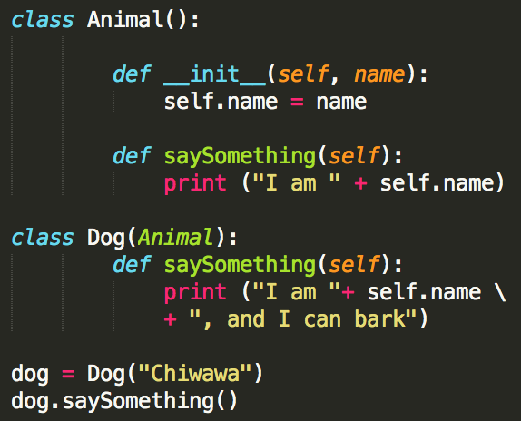
Python vs. Java
Class and Inheritance
Java
Python
→

Slide 69
Python Useful Tools
By Achint Chaudhary

Slide 70
Useful Tools
Python IDEs
Vim
Eclipse with PyDev
Sublime Text
Emacs
Komodo Edit
PyCharm

Slide 71
Useful Tools
Python Web Frameworks
Django
Flask
Pylons
Pyramid
TurboGears
Web2py

Slide 72
Who Uses Python?
By Achint Chaudhary

Slide 73
Organizations Use Python
Web Development :Google, Yahoo
Games :Battlefield 2, Crystal Space
Graphics :Walt Disney Feature Animation, Blender 3D
Science :National Weather Service, NASA, Applied Maths
Software Development :Nokia, Red Hat, IBM
Education :University of California-Irvine, SchoolTool
Government :The USA Central Intelligence Agency (CIA)

Slide 74
Final Comments
• Thanks!
• Hope you had some fun!
• Learned at least a few new things

